Slide 1
Django Overview
江琳

Slide 2
Django

Slide 3
WHAT IS DJANTO?
Django is a high-level Python Web Framework.
Rapid development
Free and open source
Has a thriving and active community.
Great documentation.

Slide 4
Where did it come from?
Django was initially developed between 2003 and 2005 by a web team who were responsible for creating and maintaining newspaper websites.
After creating a number of sites, the team began to factor out and reuse lot of common code and design patterns.
This common code evolved into a generic web development framework, which was open-sourced as the "Django" project in July 2005.

Slide 5
Django MVT pattern
Models: manage(add, modify, delete) records in database
View: A view is a request handler function, which receives HTTP requests and returns HTTP responses.
Template: is a text file defining the structure or layout
URLs: process requests from every single URL

Slide 6
Django MVT pattern
Model
Read/Write Database
HTTP Request
Url
Forward Request
View
HTTP Response
Template

Slide 7
MVC – MVT pattern
When talking about web development, we usually talk about MCV architecture.
MVC pattern is based on three components: Model, View and Controller.

Slide 8
MVC – MVT pattern
Model-View-Template (MVT)
The main deference between the two patterns is that Django itself takes care of the Controller part, leaving us with the template.
The template is HTML file mixed with Django Template Language (DTL)

Slide 9
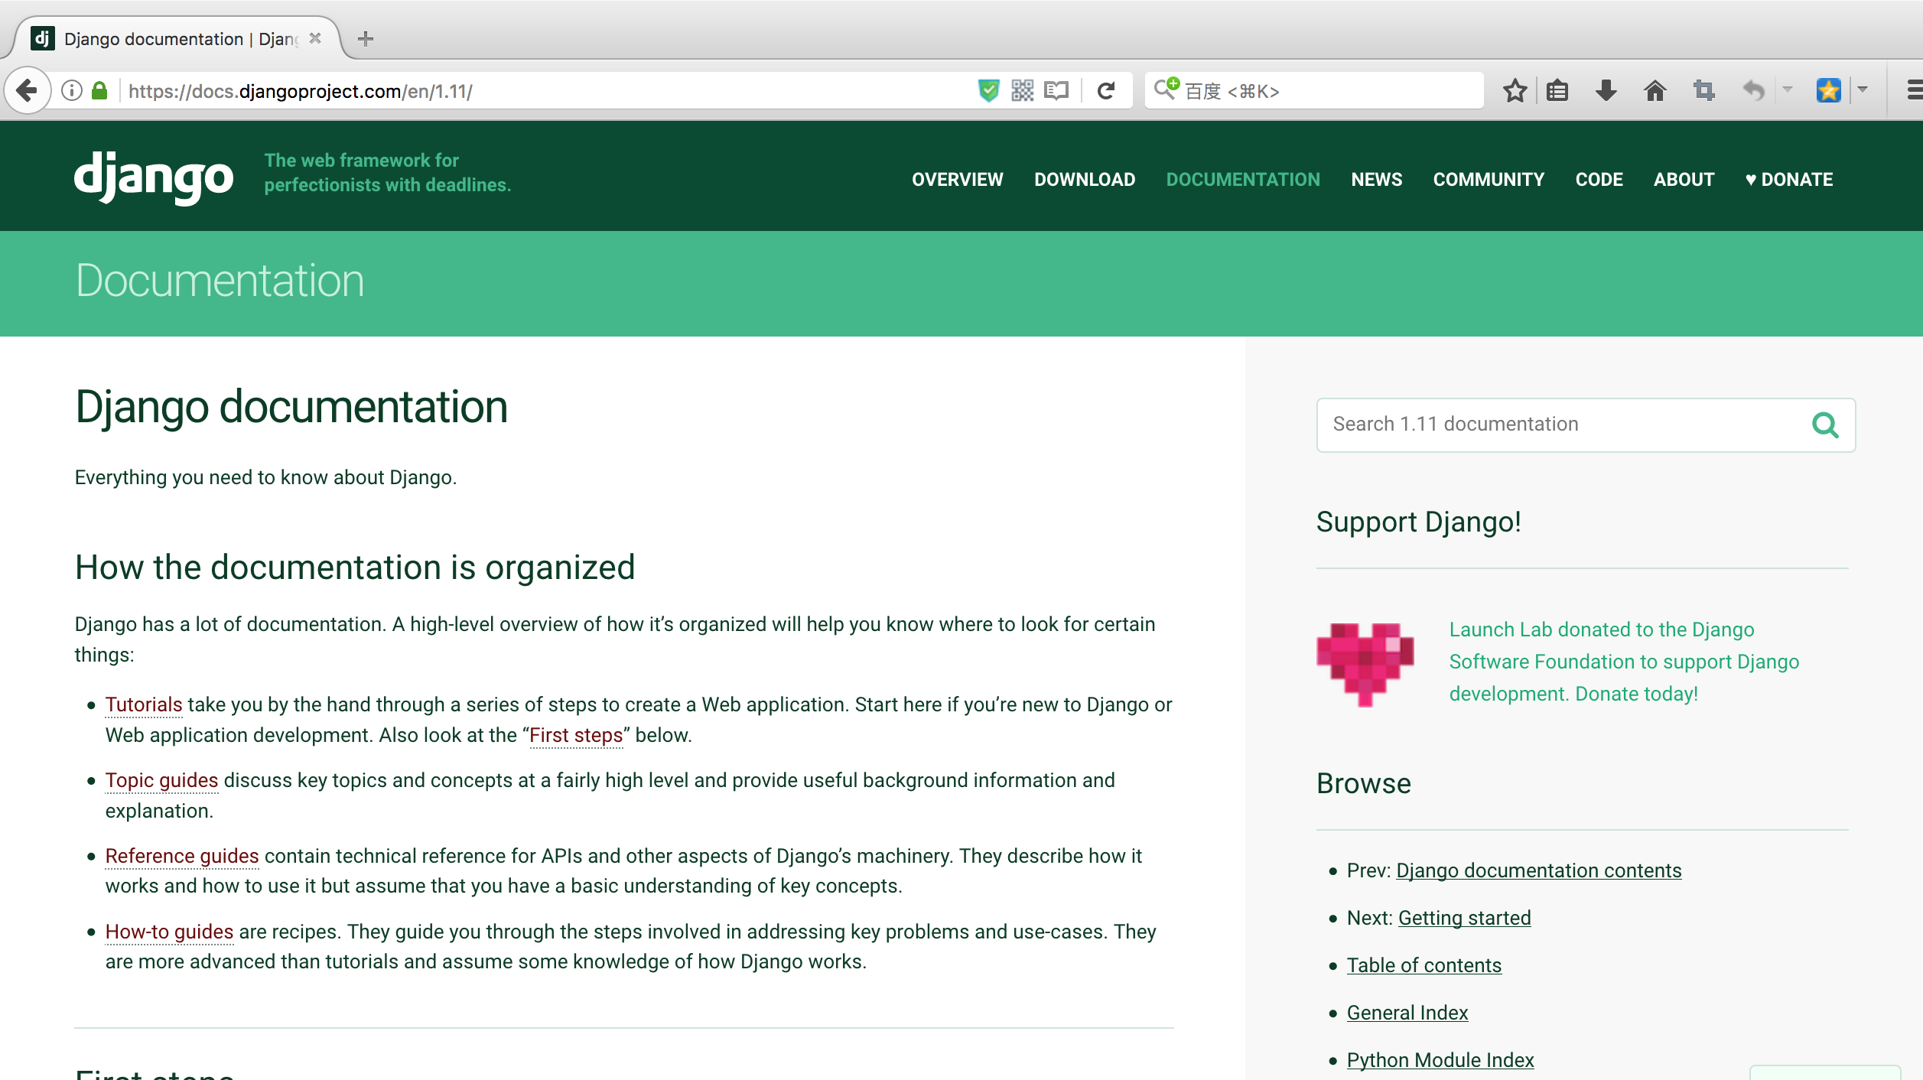
Django
https://www.djangoproject.com/
Django Documentation

Slide 10
Django Environment

Slide 11

Django setup – step 1
Check Python
Being a Python web framework, Django require Python
Before install Django, check the version of Python
$ python –V
Python 3.6.1

Slide 12

Django setup – step 2
Install Django
pip install django // install the newest version
If want to install previous version
pip install django==1.10.7
$ pip install django
# install previous version
$ pip install django==1.10.7

Slide 13
Django setup – step 3
Verify
Open terminal and type below command:
$ python
>>> import django
>>> print(django.get_version())
1.11.4

Slide 14
Let’s start a Project!
Creating Django project
Before creating, cd to the directory where you want to store your code
django-admin startproject <project_name>
# create a django project named library
$ django-admin startproject library

Slide 15
Let’s start a Project!
library
library
__init__.py
settings.py
urls.py
wsgi.py
manage.py

Slide 16
What is created?
__init__.py treat this folder as package, just for python
settings.py contains all the website settings, such as database, static file and so on.
urls.py defines the site url-to-view mapping.
wsgi.py is used to help your Django application communicate with the web server.

Slide 17
What is created?
manage.py is kind of your project local django-admin for interacting with your project via command line.
To get full list of command:
python manage.py help

Slide 18
Virtual Environments
A virtual environment is a tool to keep the dependencies required by different projects in separate places, by creating virtual Python environments from them.
It solves the “project X depends on version 1.x but project Y need version 4.x”.

Slide 19
virtualenv
Virtualenv is a tool to create isolated Python environments.
Virtualenv creates a folder which contains all necessary executables packages that a Python project would need.

Slide 20
virtualenv -- install
Install
pip install virtualenv
Test your installation
virtualenv --version
$ virtualenv --version
15.1.0

Slide 21
virtualenv -- create
Create a virtual environment for a project
$ cd project_folder
$ virualenv <env_name>
Using the Python interpreter of your choice
$ virtualenv –p python3 <env_name>
$ cd <project_folder>
$ virtualenv env
# define python version
$ virtualenv –p python2.7 env

Slide 22
virtualenv -- activate
To begin using the virtual environment, it needs to be activated.
# OS or Linux
$ source env/bin/activate
# Windows
$ env\Scripts\activate

Slide 23
virtualenv -- deactivate
If you are done working in the virtual environment for the moment, you can deactivate
(env) $ deactivate
$

Slide 24
verify
Let’s verify your Django project works.
$ cd library
$ env\Scripts\activate
(env)$ python manage.py runserver
Now, open the web page at http://127.0.0.1:8000
By default, the runserver command starts the development server on the internal IP at port 8000.

Slide 25
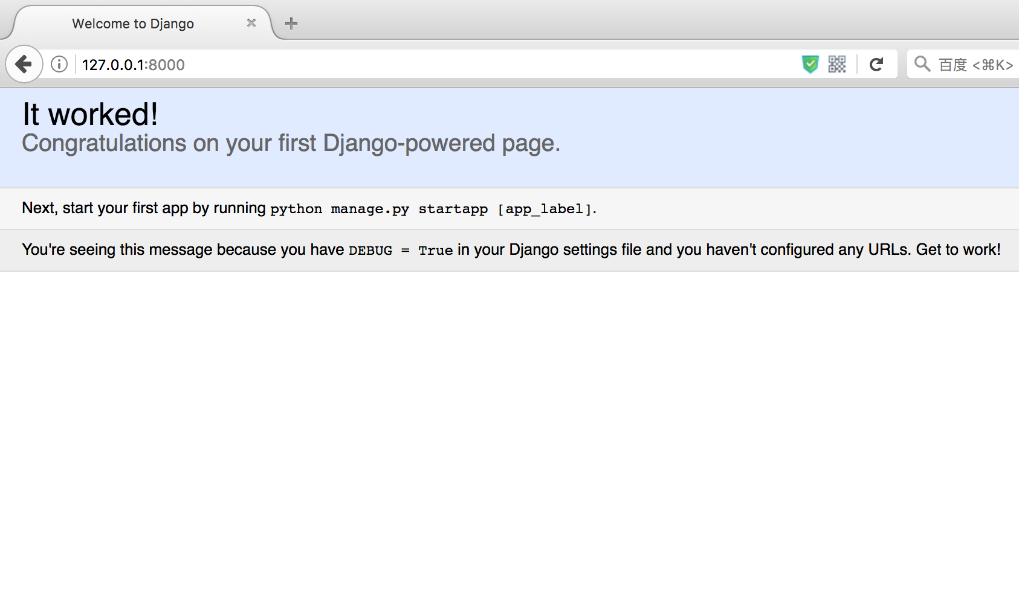
It worked!

Slide 26
Changing the port
If you want to change the server’s port, pass it as a command-line argument. For instance, this command starts the server on port 8080:
(env)$ python manage.py runserver 8080

Slide 27
Changing the port
If you want to change the server’s IP, pass it along with the port.
(env)$ python manage.py runserver 0.0.0.0:8000
Open settings.py
ALLOWED_HOSTS = ['*']

Slide 28
pycharm
PyCharm
Python IDE for Professional Developers

Slide 29
Questions?

